Slide 1
ENGLISH POWERPOINT PRESENTATION

Slide 2
MINIMAL PAIRS
WORD ACCENT AND STRESS SHIFT
LISTENING COMPREHENSION

Slide 3
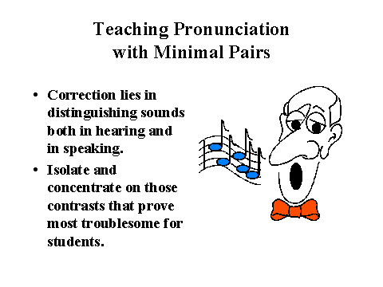
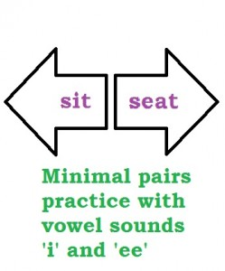
MINIMAL PAIRS
A minimal pair is a pair of words that vary by only single sound
Vowel Sounds
Consonant sound
Initial Consonant sound
Final Consonant sound

Slide 4
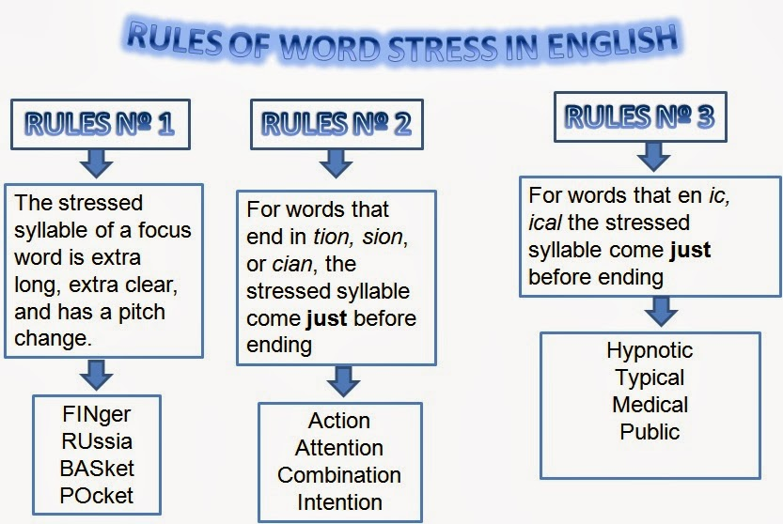


WORD ACCENT AND STRESS SHIFT
SYLLABLE
STRESS
Sentence Stress
Word stress

Slide 5

LISTENING COMPHREHENSION
Receptive skill in oral mode
Tips to improve your Listening skills
High stakes active listening situations
Communication
The less u speak the more u hear
Respond appropriately
Do not be preoccupied by your own thoughts.

Slide 6
Description-Narrations
Giving Directions and Guidelines
Questions Tags and
One-word substitutes

Slide 7
DESCRIPTIONS-NARRATIONS
Describing: Describing is something which involves recreating your experiences and impressions.
use
components
characteristics
position
connection between parts

Slide 8
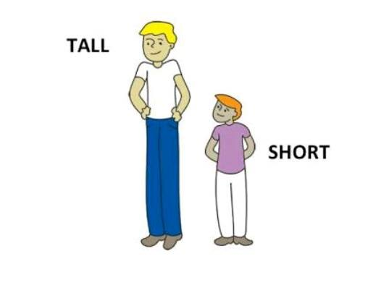
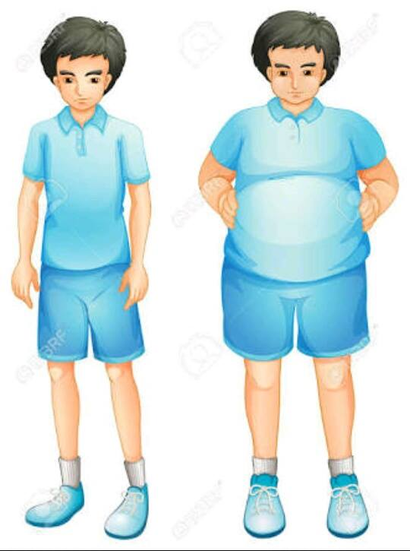



Describing a person
height
build
type of hair
eyes
other features(beard, moustache, teeth, lips etc)
Long Hair Short Hair Curly Hair

Slide 9
GIVING DIRECTIONS
Giving directions is one of the methods of transferring information
Important words and phrases in showing the directions are:
To your left
To your right
Go a head
In front of
behind etc.

Slide 10
Question tags
Question tags are the short questions at the end of statement.
1.a positive statement is followed by negative tag.
Eg. : You won't fail the exam, will you?
2.A negative statement is followed by positive question tag.
Eg: We must be patient, mustn't we?

Slide 11
INTONATION AND
COMMON ERRORS IN PRONUNCIATION
NEUTRALIZATION OF MOTHER TONGUE
INFLUENCE

Slide 12
INTONATION AND COMMON ERRORS IN PRONUNCIATION
The rise and fall of the voice in speaking.
TUNE OR TONE SHAPES
THE FALLING TUNE Ex: exclamations, question tags, rhetorical questions
THE RISING TUNE Ex: enumeration , polite request, expected responses
THE FALLING RISING TUNE

Slide 13
NEUTRALIZATION OF MOTHER TONGUE INFLUENCE
PRACTICE MAKES MAN PERFECT
MOTHER TONGUE INFLUENCE ON PREPOSITIONS
HOW CAN WE IMPROVE OUR SPEECH ???
Look up to dictionary
Listen to the native speakers of English
Read news paper
Record yourself while reading

Slide 14
TOPICS :
• EXTEMPORE - PUBLIC SPEAKING
• ACTIVE AND PASSIVE VOICE
• COMMON ERRORS IN ENGLISH
• IDIOMS AND PHRASES

Slide 15
EXTEMPORE-PUBLIC SPEAKING
What do you mean by extempore speech?
-
Extempore tests the candidates on the following:-
▪ Ability to think on the feet
▪ Prioritization and sequencing displaying logical thinking
▪ Ability to connect with the panel
▪ Communication skills
▪ Overall presentation skills-body language, confidence, poise, composure etc. For effective
extempore speaking - candidates must be fluent and well read.
SOME TIPS
• Mental Preparation
• Start speaking at an even pace
• Control on speech

Slide 16
ACTIVE AND PASSIVE VOICE
• In most English sentences with an action verb, the subject performs the action denoted by the verb. These examples show that the subject is doing the verb's action..
COMMON ERRORS IN ENGLISH
• Incorrect: Why you were late?
• Correct: Why were you late?
• Incorrect: Why you did not come?
• Correct: Why didn’t you come? In questions the auxiliary verb comes before the subject.
• Incorrect: Let us discuss about this matter.
• Correct: Let us discuss this matter. The verb discuss does not take a preposition before the object.
• Incorrect: He informed the death of his mother to me.
• Correct: He informed me about the death of his mother. We inform somebody about something.
.

Slide 17
IDIOMS AND PHRASES
What is the phrase in a sentence?
• A phrase is a group or words that express a concept and is used as a unit within a sentence. Eight common types of phrases are: noun, verb, gerund, infinitive, appositive, participial, prepositional, and absolute.
SOME EXAMPLES OF IDIOMS AND PHRASES ARE : ‘The best of both worlds’ – means you can enjoy two different opportunities at the same time.
• “By working part-time and looking after her kids two days a week she managed to get the best of both worlds.”
‘Speak of the devil’ – this means that the person you’re just talking about actually turns up at that moment.

Slide 18
INFORMATION TRANSFER
ORAL PRESENTATION SKILLS
READING COMPREHENSION
RESUME WRITING

Slide 19
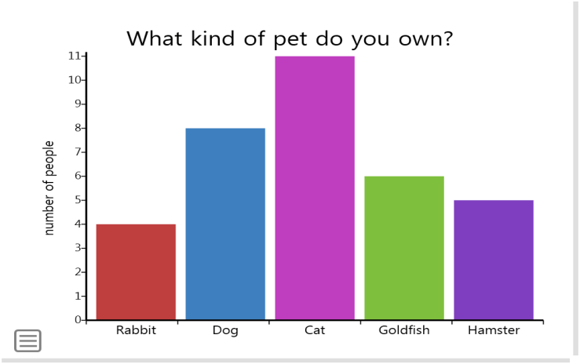

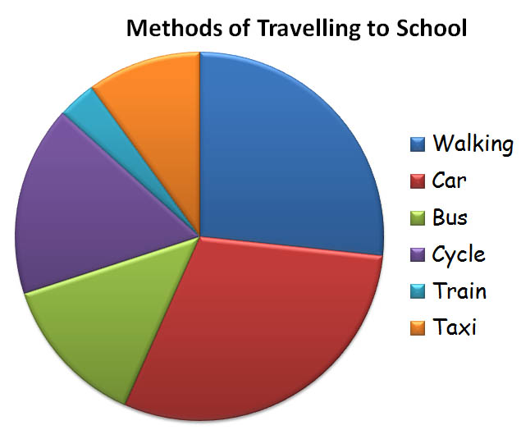
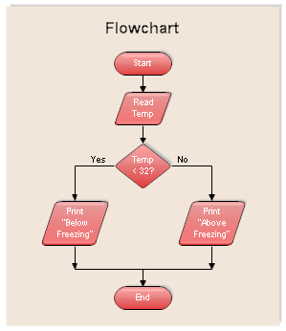
INFORMATION TRANSFER
The process of transferring information from one person to another
BAR GRAPHS TREE DIAGRAMS
PIE CHARTS FLOW CHARTS

Slide 20
ORAL PRESENTATION
Presentation Content
Creating attention
Body Language
Relax
Visual aids
interact
CONFIDENCE
BODY LANGUAGE
NOTES

Slide 21
READING COMPREHENSION
Pre-planned Strategies
PURPOSE???
Self Questioning
Main Idea\Concept
Understanding
Drawing Conclusions
Testing
Try to Explain to others.

Slide 22
RESUME WRITING
Personal Interview
Abilities, Achievements
It is divided into three sections
Introduction
Primary
Secondary
Experience
Education Qualifications

